Slide 1

ANALYZING THE GENDER WAGE GAP IN THE U.S.
LMU Datathon 2025 – Graduate Track

Slide 2

Team Members
Team number 05
01
Aryan Khunt
02
Rutvik Kuttchi
03
Manav Mangukiya
04
Gaurav Salvi

Slide 3

Introduction – Framing the Problem
01.
Estimate the gender-wage gap
OBJECTIVE
SATEKHOLDERS
CORE CONCERN
Persistent wage inequality between men and women across different U.S. subpopulations
U.S. policy makers, labor economists, equality-focused organizations

Slide 4

Data & Methodology
Data Points: 500K+
Columns: 42
2021 American Community Survey (ACS) Public Use Microdata Sample
Contains demographic, income, citizenship, education, and employment variables

Slide 5

Feature Engineering
Total Work Done = UHRSWORK × WKSWORK1
Grouped transportation methods into 3 categories
Determined citizenship status using CITIZEN, YRNATUR, and BPL
Transformed income (log) to reduce skewness
Removing Multi-Colinear columns

Slide 6
Hypothesis Test
T test findings
⁠The t-statistic of 74.16 indicates an extremely large difference in average wages between genders relative to the data’s
This strongly rejects the null hypothesis, confirming a statistically significant gender wage gap.

Slide 7
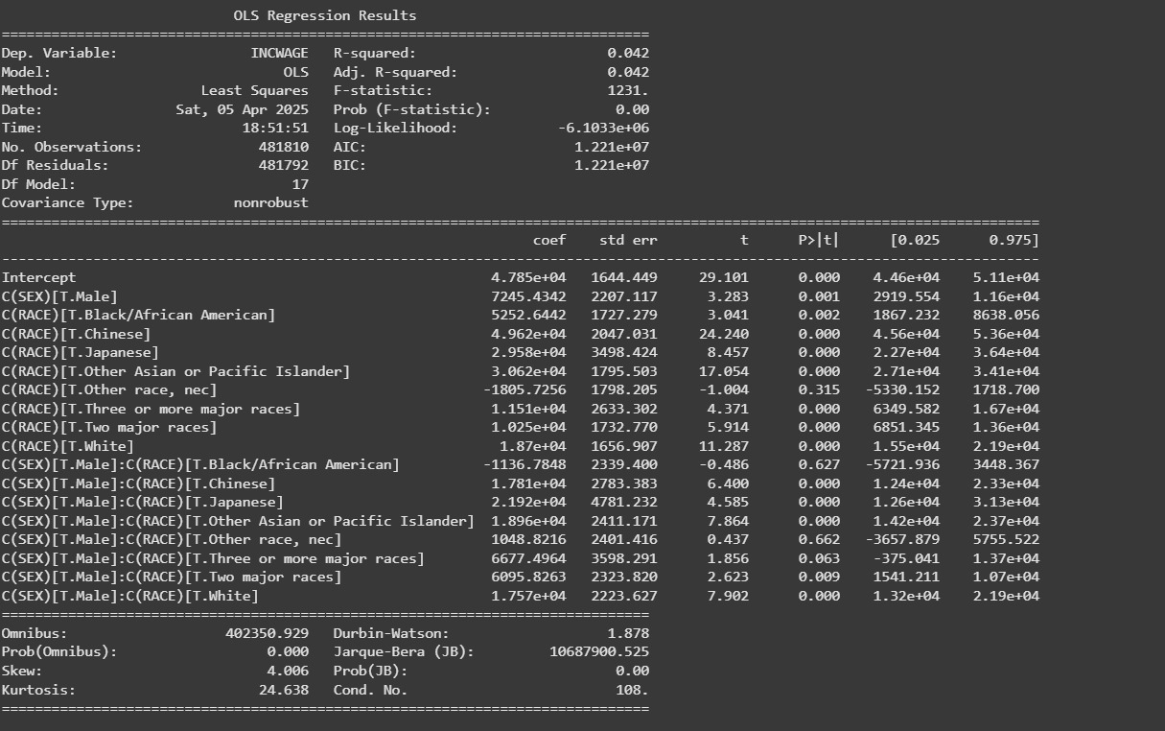

Slide 8

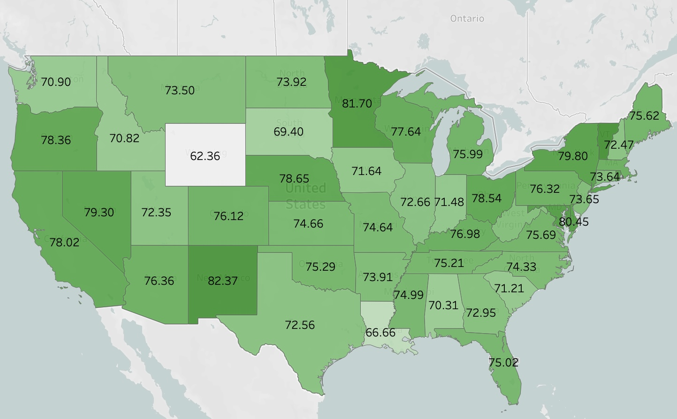

Slide 9
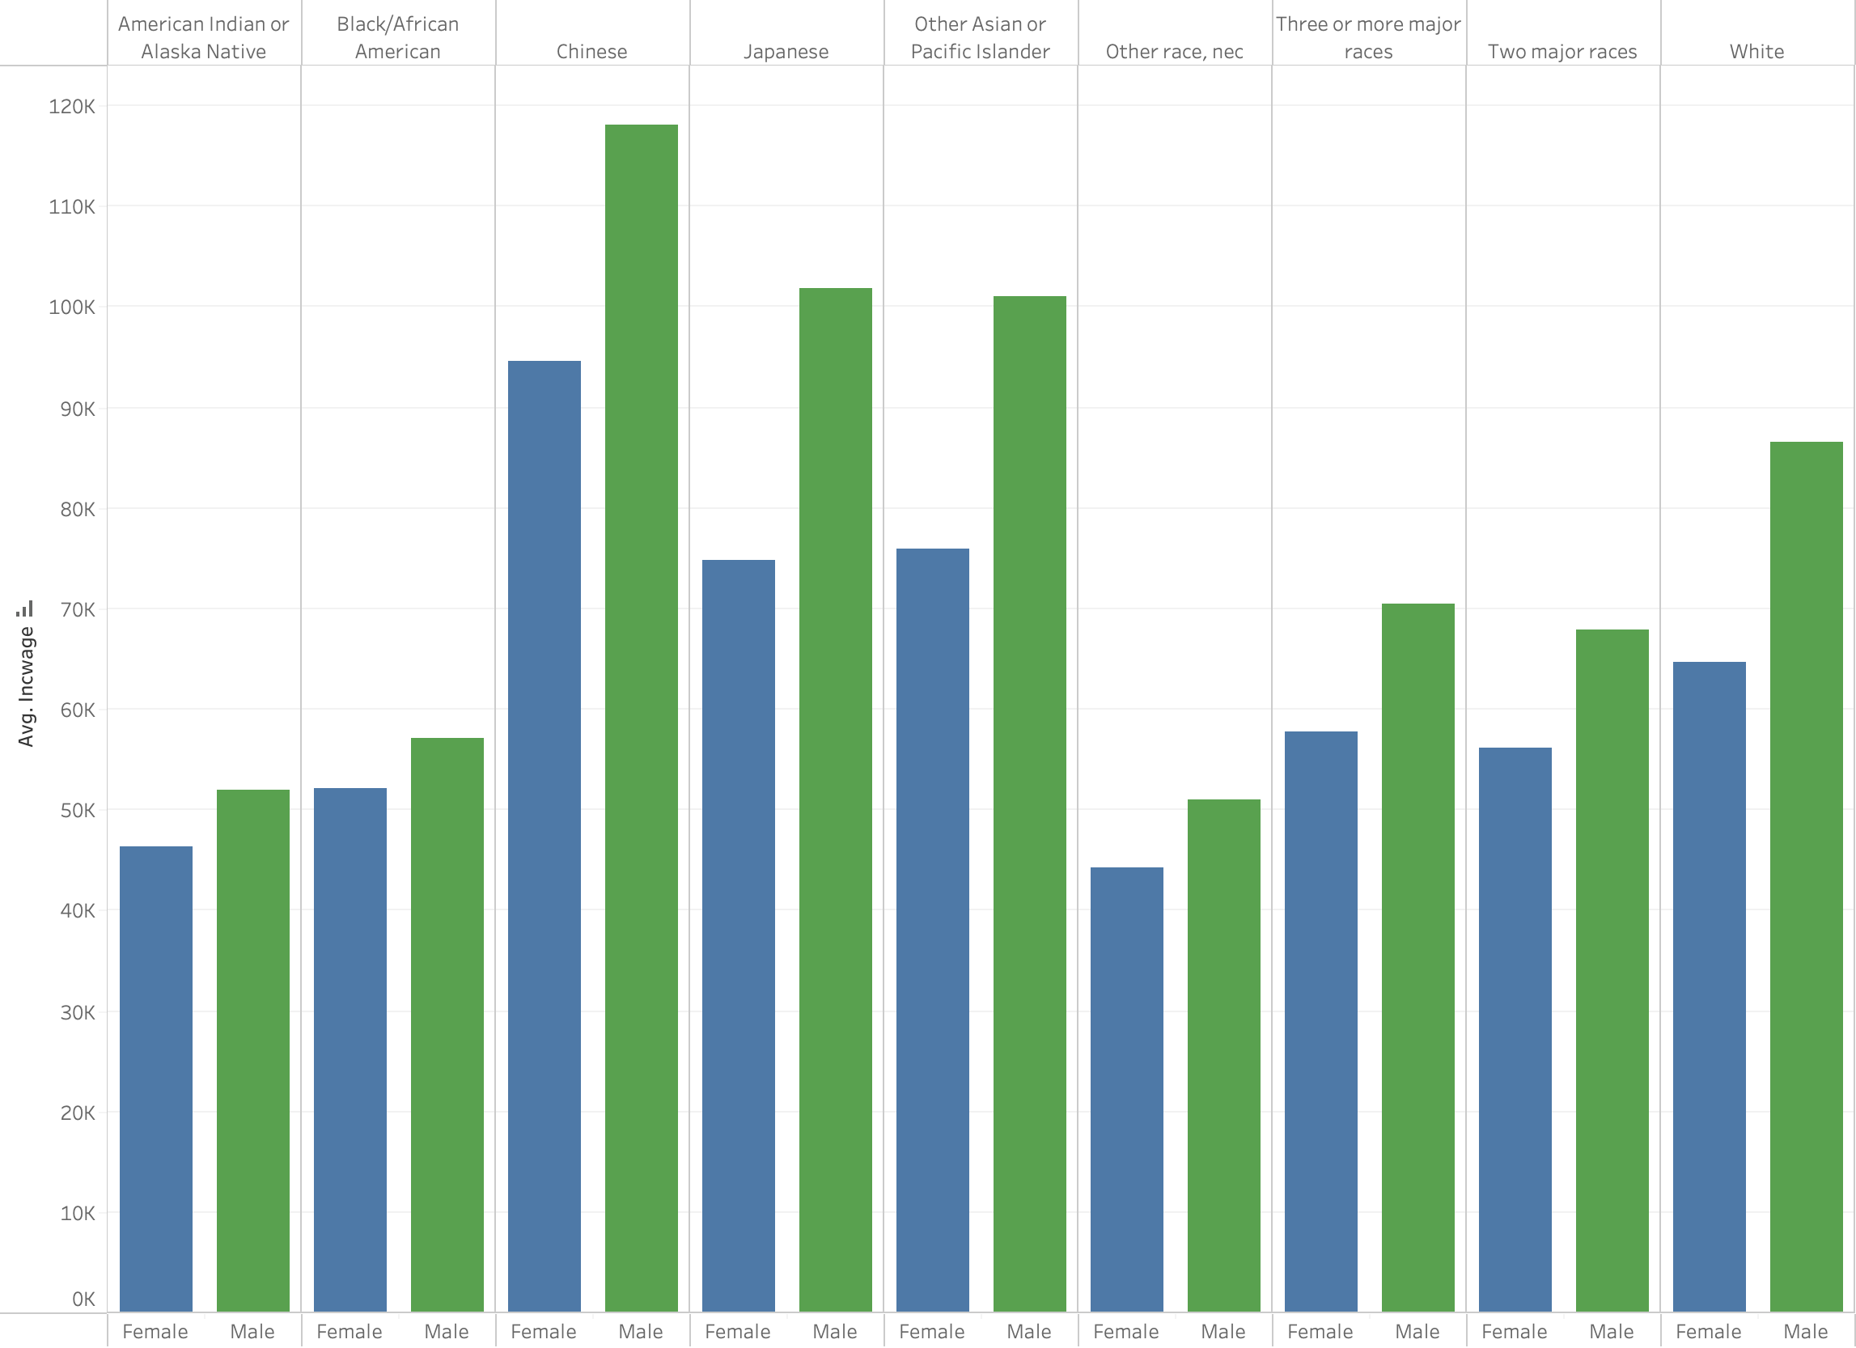

Slide 10
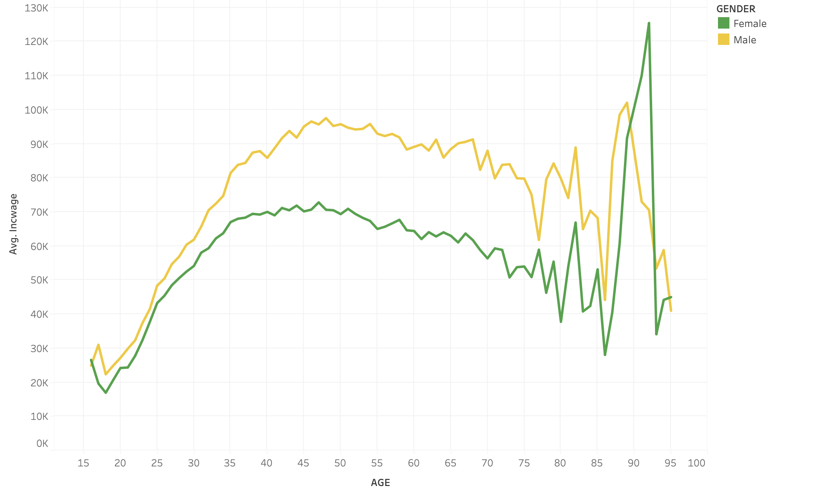

Slide 11

Recommendation
Limitations
Organizations should adopt pay transparency and targeted diversity initiatives to address the significant gender wage gap.
Our analysis shows clear inequities across gender, race, and occupation, despite limitations from omitted variables and survey design.
These findings underscore the need for immediate, focused policy and organizational actions to ensure fair compensation.

Slide 12
THANK YOU

